Slide 1
Graph-based methods for NLP
Brin, S. and Page, L. (1998). The anatomy of a large-scale hypertextual web search engine. Computer Networks and ISDN Systems, 30(1-7), 107–117.
Erkan, G. and Radev, D. R. (2004). Lexrank: Graph-based lexical centrality as salience in text summarization. Journal of Artiﬁcial Intelligence Research (JAIR), 22, 457–479.
Mihalcea, R. and Tarau, P. (2004). Textrank: Bringing order into texts. In Proceedings of the conference on Empirical Methods in Natural Language Processing (EMNLP-04), pages 404–411, Barcelona, Spain.
Mihalcea, R. and Radev, D. (2011). Graph-based Natural Language Processing and Information Retrieval. Cambridge University Press
graphs, networks, PageRank, graph clustering
18/06/19
Language Technology Group – Chris Biemann

Slide 2
Graphs in NLP
Some (language) data is naturally represented as a graph
Graph G(V,E) with V = set of nodes, E = set of edges
nodes can be (multi-)labeled, weighted
edges can be weighted, typed, directed or undirected
Graphs encode relationships between entities, which are represented as nodes
animal
Tier
typed, directed edge
edge weight
bellt 5
transl.
4.22
Hund 17
undirected edge
is-a
is-a
is-a
node label
3.5
Hund
Katze
Maus
Katze 25
node weight
18/06/19
Language Technology Group – Chris Biemann
node with two labels

Slide 3
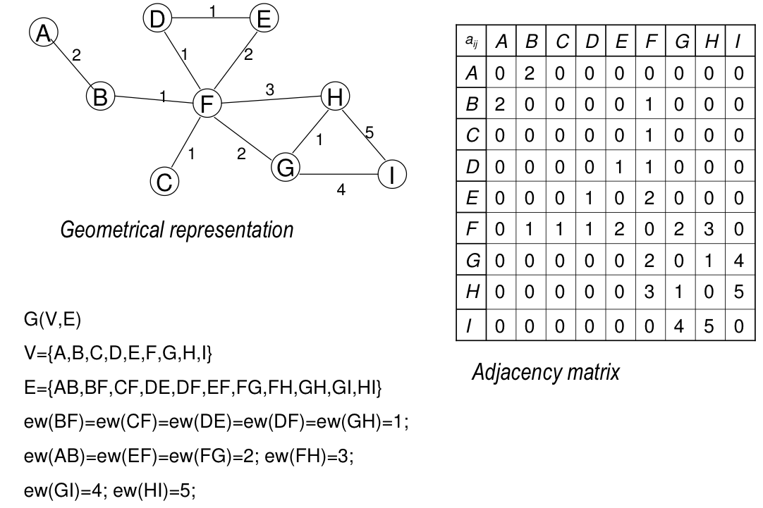
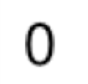
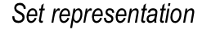
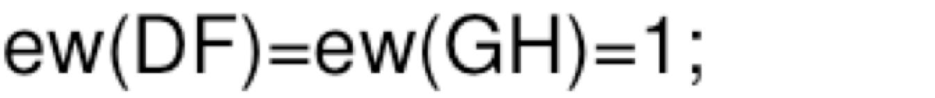
Graph representations
18/06/19
Language Technology Group – Chris Biemann

Slide 4
Motivation for Graph Representation
Graphs are an intuitive and natural way to encode language units as nodes and their similarities as edges
feature-based representation can be transformed into a graph via a similarity measure
graphs cannot be transformed back into the feature representation.
Think e.g. points in space
There exist methods that directly operate on graphs
graph clustering, e.g. MinCut
graph-based ranking, e.g. PageRank
path-based algorithms, e.g. Dijkstra
Representation as adjacency matrix A: A(i,j)=weight of edge (i,j)
18/06/19
Language Technology Group – Chris Biemann

Slide 5
Page Rank for Web Pages
First-generation Google global ranking algorithm (1998)
Measure the (query-independent) importance of Web page based on the link structure alone.
Assign each node a numerical score between 0 and 1: PageRank.
Rank Web pages based on PageRank values.
Idea:
Every page has a number of in-links (back links) and out-links (forward links)
pages with more in-links are more important
in-links from important pages are more important
Back in 1998, there were no link farms.
Charles H. Hubbell: An input-output approach to clique identification. In: Sociometry 28, pp. 377-399, 1965
18/06/19
Language Technology Group – Chris Biemann

Slide 6
Definition of PageRank
u: a web page. R_{u} its page rank
F_{u}: set of pages u points to
B_{u}: set of pages that point to u
|F_{u}|: the number of links from u
N: total number of pages
d: damping factor, default d=0.85
page B
The equation is recursive, but it may be computed by starting with any set of ranks and iterating the computation until it converges.
Rank sink problem: ring of pages that accumulated rank, but never distributes rank
Need damping: uniform rank distribution for all pages
page A
page C
page D
page X
18/06/19
Language Technology Group – Chris Biemann

Slide 7
Random Surfer Model
When normalizing PageRank over all pages, R(u) can be thought of as the probability that a random surfer looks at page u.
Damping corresponds to “teleportation”: With some probability d, the random surfer is teleported to some other page
page B
page X
page A
page C
page D
18/06/19
Language Technology Group – Chris Biemann

Slide 8
Matrix notation
PageRank can be written as R=(1-d)D + [dB]^{T}R where
D is a vector of dimension N where all elements are equal to 1/N
B is a a stochastic version of the adjacency matrix
Stationary distribution: If a stochastic matrix X is irreducible and aperiodic, there exists a unique stationary distribution r
irreducible: path between all nodes
aperiodic: no rank sinks
Teleportation with damping factor makes the effective transition matrix irreducible and aperiodic!
18/06/19
Language Technology Group – Chris Biemann

Slide 9
Computation of PageRank
Numeric: Simulate a lot of random surfers: The Power method of Eigenvector computation
initialize all pages with the same rank
repeat until convergence:
for all pages u: compute R_{t+1}(u) on the basis of R_{t}(v)
t:=t+1
input : matrix size N , error tolerance ϵ
output: eigenvector p
p₀ = 1/N 1
t=0;
repeat until δ < ϵ:
t=t+1;
p_{t} = M^{T}p_{t−1} ;
δ = ||p_{t} − p_{t−1} ||;
return p_{t} ;
18/06/19
Language Technology Group – Chris Biemann

Slide 10
LexRank: Application to Multi-Document Summarization
Multi-document summarization:
identify important topics of the documents to be summarized
identify sentences belonging to a certain topic
from sentences belonging to the same topic, select the ones that best describe the topic
concatenate sentences from different topics and make sure they fit together
Sub-problem 3.:
input: Sentences that talk about more or less the same thing
output: scores for those sentences that reflect how well a single sentence represents that topic
Idea: use measures on sentence similarity graph
18/06/19
Language Technology Group – Chris Biemann

Slide 11
From Sentences to TF*IDF vectors
TF: count w₁..w_{n}
TF*IDF
Sentence
w1
3
5
7
w2
0
0
4
w3
2
3
0
wn
0
1
0
w1
0
0
0
w2
0
0
.62
w3
.27
.24
0
wn
0
.21
0
This is a sentence that talks about some topic.
feature vector of the second sentence
And here is another sentence that talks abot something slightly different.
…
…
This is the same as the vector space model for Information Retrieval
And here is yet another one of these notorious sentences
DF | 3 | 1 | 2
…
1
18/06/19
Language Technology Group – Chris Biemann

Slide 12
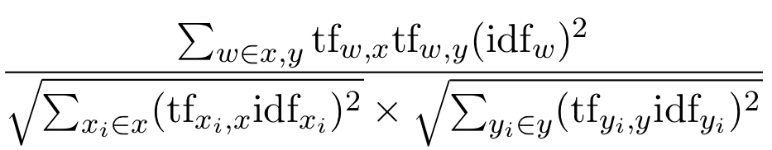
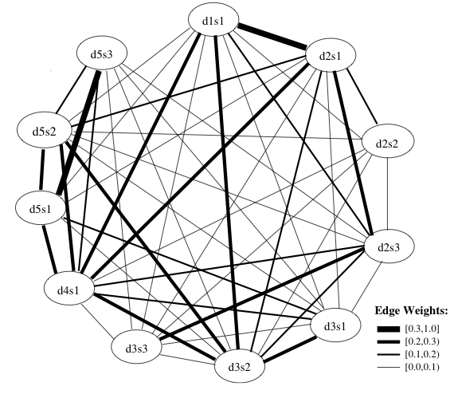
From TF*IDF vectors to sentence similarity graph
Sentence similarity graph:
nodes: sentences
edges: cosine similarity between sentence feature vectors
Can apply threshold on similarity or use similarity as edge weight
Could use any other method that produces sensible sentence vectors
18/06/19
Language Technology Group – Chris Biemann

Slide 13
Centroid, Degree and Centrality
Centroid
idea: select average sentence. Compute average point of sentence vectors (centroid)
select sentence that is most similar to the centroid for summarization
Degree Centrality
idea: sentences that cover most of the content have a high node degree (number of edges): since word overlap is responsible for edges, degree measures word overlap with the overall set of sentences
for summarization, choose the sentence with the highest degree
LexRank Centrality
idea: it does not suffice to be similar to many sentences: similarity to important sentences counts more.
normalize the adjacency sentence similarity to make it a stochastic matrix
run PageRank to obtain scores that are used for ranking the sentences
for summarization, choose sentence with highest score
18/06/19
Language Technology Group – Chris Biemann

Slide 14
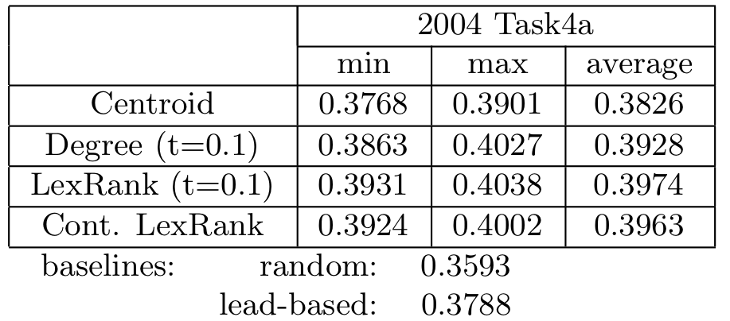
Evaluation of graph-based multi-document summarization
Scores: ROUGE metric: similar to BLEU, between manual summaries and system summaries
random baseline: select any sentence from set by chance
lead-based: select based on position of sentence within document
LexRank is a simple method for getting high scores. It uses the whole structure of the graph, as opposed to Centroid or Degree.
This technique also works well for single-document summarization.
18/06/19
Language Technology Group – Chris Biemann

Slide 15
Co-occurrence Graphs
If two words X and Y occur together in some contextual unit of information (as neighbors, in a word window of 5, in a clause, in a sentence, in a paragraph), they are said to co-occur.
When regarding words as vertices and edge weights as the number of times two words co-occur, the word co-occurrence graph of a corpus is given by the entirety of all word co-occurrences
To ﬁnd out whether the co-occurrence of two speciﬁc words A and B is merely due to chance or exhibits a statistical dependency, measures are used that compute, to what extent the co-occurrence of A and B is statistically signiﬁcant.
Significance formulas involve
n: number of ‘experiments’
n_{A}: number of experiments where A takes part
n_{B}: number of experiments where B takes part
n_{AB}: number of experiments where A and B co-occur
18/06/19
Language Technology Group – Chris Biemann

Slide 16
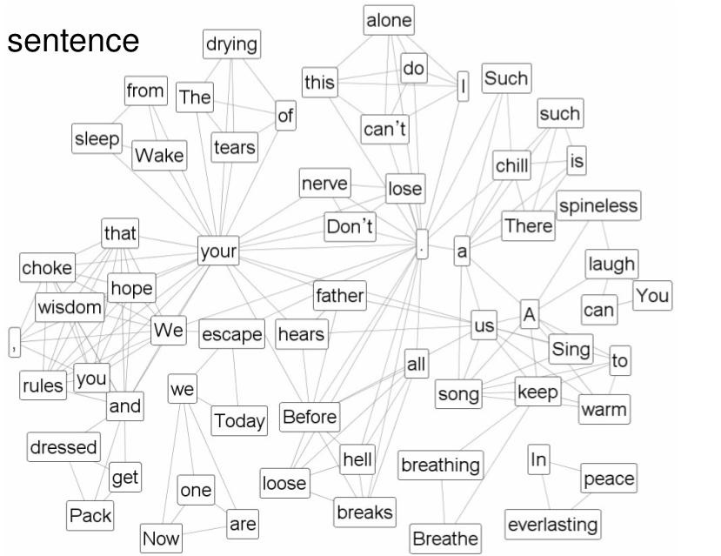
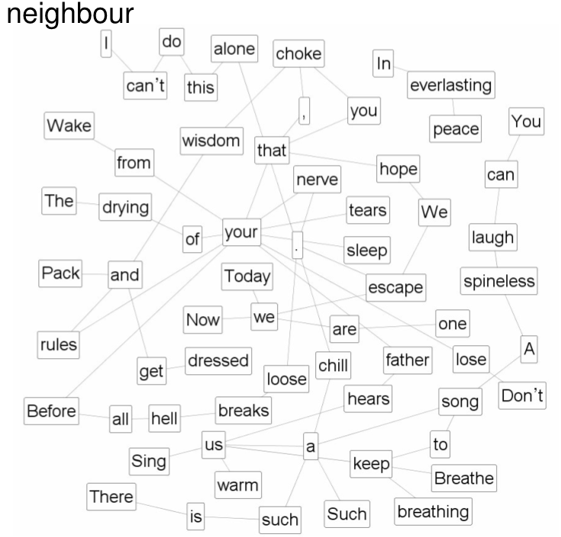
Examples of Co-occurrence Graphs
Exit Music (for a film) - Radiohead
Wake from your sleep
The drying of your tears
Today we escape
We escape.
Pack and get dressed
Before your father hears us
Before all hell breaks loose.
Breathe keep breathing
Don’t lose your nerve.
Breathe keep breathing
I can’t do this alone.
Sing us a song
A song to keep us warm
There is such a chill
Such a chill.
You can laugh
A spineless laugh
We hope that your rules
and wisdom choke you
Now we are one
In everlasting peace
We hope that you choke,
that you choke
We hope that you choke,
that you choke
We hope that you choke,
that you choke
18/06/19
Language Technology Group – Chris Biemann

Slide 17
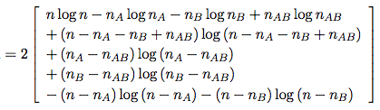
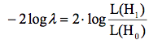
Significance Measures
n: number of ‘experiments’
n_{A}: number of experiments where A takes part
n_{B}: number of experiments where B takes part
n_{AB}: number of experiments where A and B co-occur
Joint Frequency sig(A,B) = n_{AB}
Pointwise Mutual Information
Lexicographer’s Pointwise Mutual Information
Log-Likelihood ratio
… or any other statistical significance test
18/06/19
Language Technology Group – Chris Biemann

Slide 18
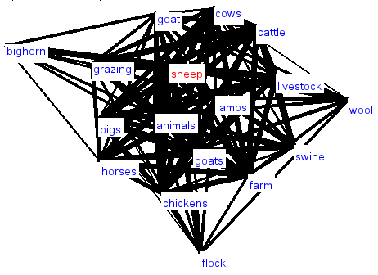
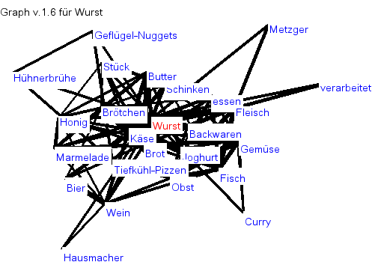
Co-occurrence Graphs from Large Corpora http://corpora.informatik.uni-leipzig.de/
Local neighborhoods: top significant co-occurrences, and their top significant connections
Mix of syntactic and semantic relations
18/06/19
Language Technology Group – Chris Biemann

Slide 19
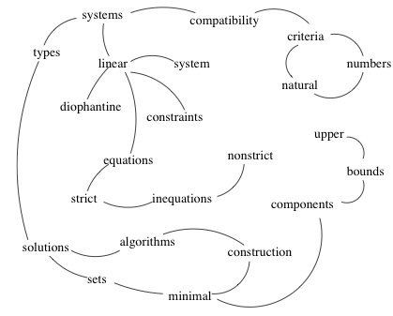
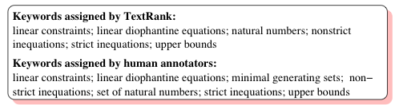
TextRank for Keyword Extraction
Keyword extraction: find the most salient keywords for a document
Keyword extraction with PageRank:
preprocess document: identify adjectives and nouns as targets
target co-occurrence graph: targets co-occurring within a window of 2-10 words
apply PageRank to get ranking scores on nodes
select highest scoring keywords, possibly concatenate ADJ-NOUN-NOUN sequences if present in the text
18/06/19
Language Technology Group – Chris Biemann

Slide 20
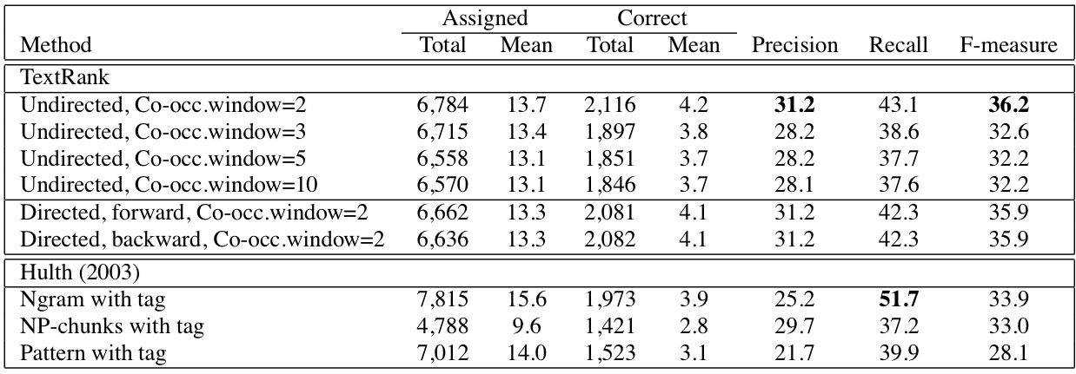
Keyword Extraction Evaluation
Comparison: Supervised system that is trained on manually assigned keywords, using frequency and contextual features
Note that TextRank is unsupervised: no training necessary
18/06/19
Language Technology Group – Chris Biemann

Slide 21
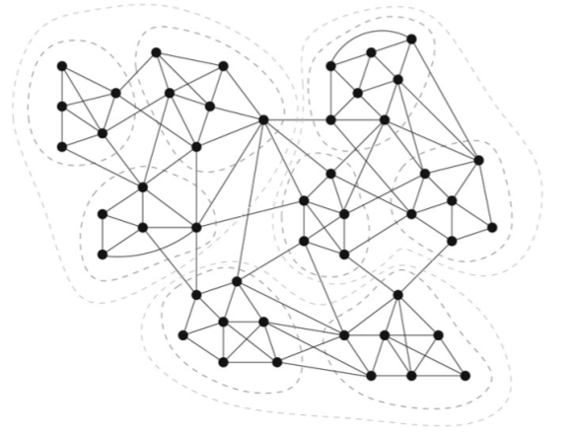
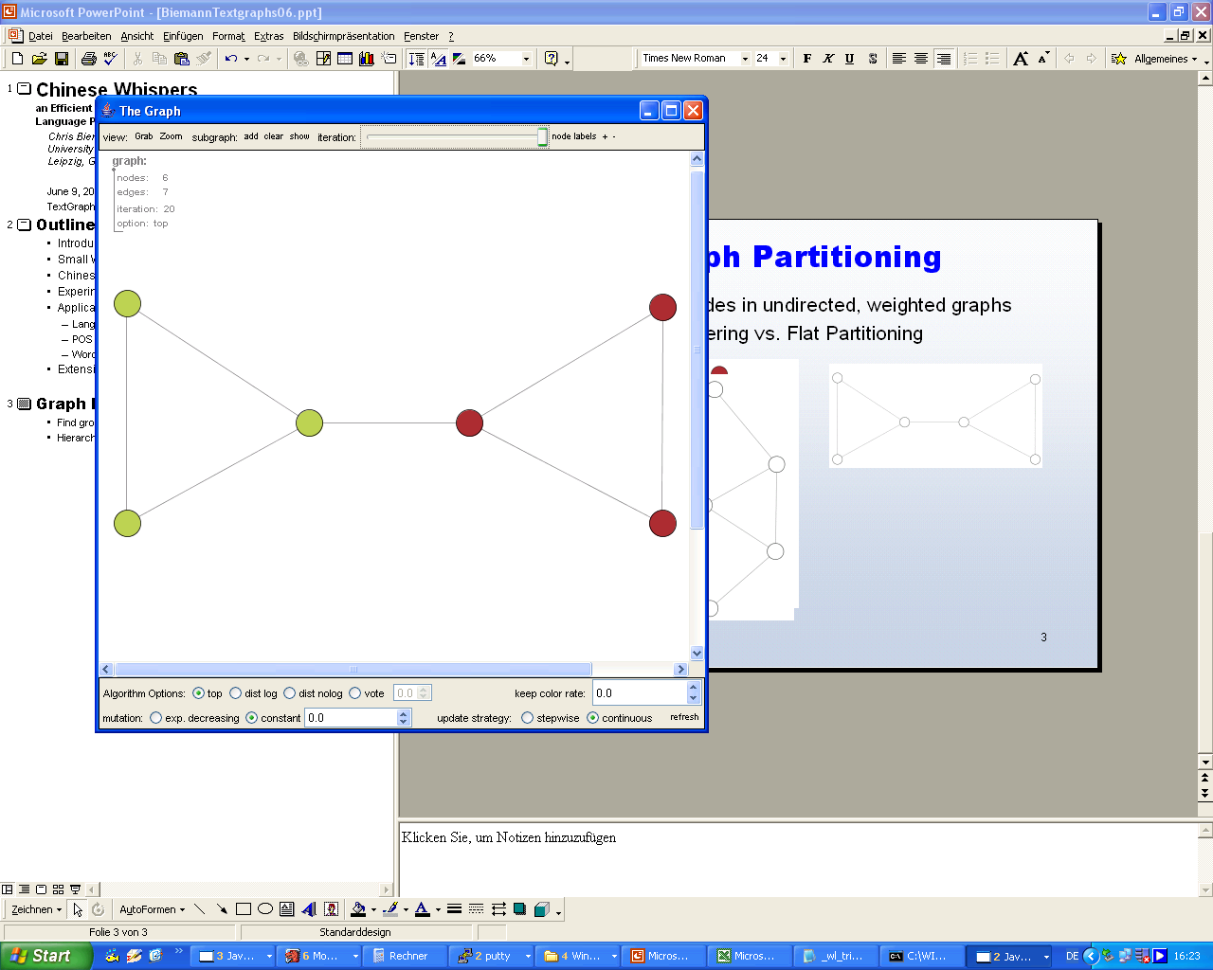
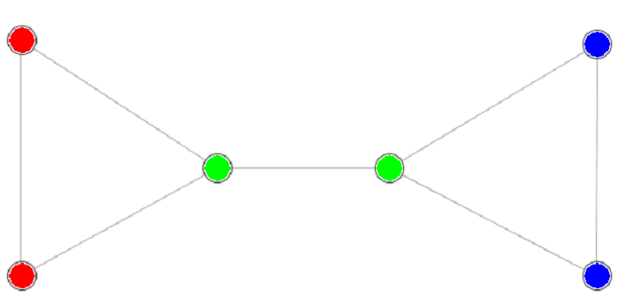
Graph Clustering
Task: Find meaningful groups of nodes in graph by cutting edges
Intuition: Connectedness within a cluster is higher than between clusters
Many graph clustering algorithms detect the number of clusters automatically
3
3
3
18/06/19
Language Technology Group – Chris Biemann

Slide 22
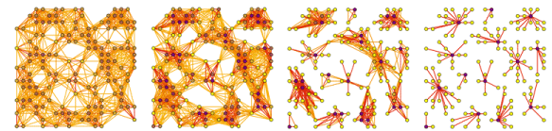
Markov Chain Clustering
Clustering based on random walks: MCL is the parallel simulation of all possible random walks up to a finite length on a graph G
Idea: a random walker on the graph is more likely to stay within the same cluster than to end up in a different cluster after a small number of steps
Algorithm: can show convergence to a limit T
Add loops: transition matrix T= column-normalize (A_{G} + I)
MCL process: alternate between
T=T^{t} // expansion: raise T to its power of t
T=inflate(T) // inflation: increase contrast within columns by raising values to their power of s (s>0) and normalize column-wise
Interpret T as a clustering: use strongest connection as label
Stijn van Dongen, Graph Clustering by Flow Simulation. PhD thesis, University of Utrecht, May 2000.
18/06/19
Language Technology Group – Chris Biemann

Slide 23
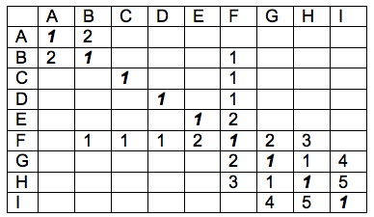
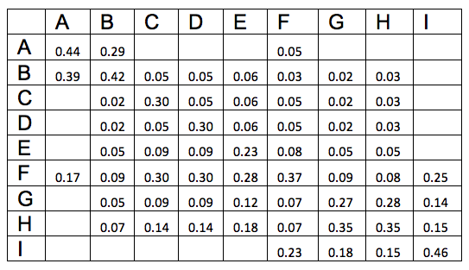
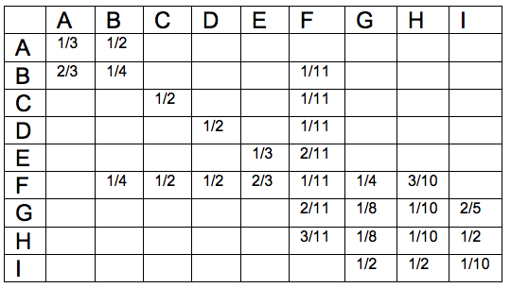
BAD Expansion step: simulate the random walk
(stochastic) adjacency matrix T: probabilities to walk from node in column to node in row in a single step.
T²: probabilities to walk from A to B in 2 steps.
A_{G} loops added
T
T²
18/06/19
Language Technology Group – Chris Biemann

Slide 24
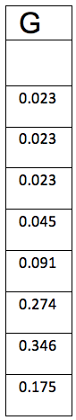
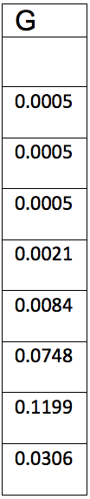
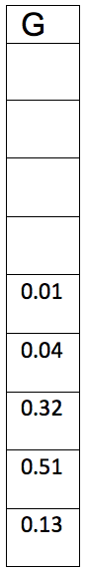
BAD Inflation Step: only keep attractors
x²
…
normalize
x²
…
x²
Inflate the differences within a column by taking the k-th power of the value, then normalize to ensure stochastic property. k regulates the cluster sizes
Clustering: Highest entry in column vector is cluster label
Variants:
Could add small random noise to break ties
Optimization: Only keep K largest values, only keep values over threshold
18/06/19
Language Technology Group – Chris Biemann

Slide 25
Chinese Whispers Graph Clustering
MCL: keep only a few strong neighbors
Chinese Whispers: only propagate strongest label in neighborhood
initialize: forall v_{i} in V: class(v_{i})=i;
while changes:
forall v in V, randomized order:
class(v)=highest ranked class in neighborhood of v;
Nodes have a class and communicate it to their adjacent nodes
A node adopts one of the majority class in its neighbourhood
Nodes are processed in random order for some iterations
Node weighting schemes
B
L4
D
L2
8
5
deg=2
A
L1
deg=1
3
E
L3
C
L3
6
deg=4
deg=3
deg=5
18/06/19
Language Technology Group – Chris Biemann

Slide 26
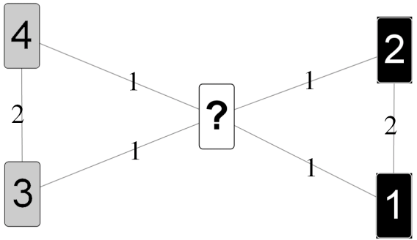
Properties of Chinese Whispers
Advantages:
Efficiency: CW is time-linear in the number of edges. This is bound by n² with n= number of nodes, but in real world data, graphs are much sparser
Parameter-free: this includes number of clusters
Disadvantages:
Non-deterministic: due to random order processing and possible ties w.r.t. the majority.
Does not converge: See bowtie tie example:
The disadvantages are usually not severe for NL data.
Biemann, C. (2006): Chinese Whispers - an Efficient Graph Clustering Algorithm and its Application to Natural Language Processing Problems. Proceedings of the HLT-NAACL-06 Workshop on Textgraphs-06, New York, USA.
18/06/19
Language Technology Group – Chris Biemann

Slide 27
Application: Language Separation
When downloading the internet, we don’t know what languages are there. It would be useful to sort the pages by language
Idea: Train a language classifier on text of known language
Material for supervised training:
German: Als ich in der Schule war, gab es noch keine Handys. Es war noch nicht möglich, in der Pause zu telefonieren.
English: It does not rain a lot in the Sahara desert. In a way, it is one of the driest regions of the world.
Model: most frequent words:
German: ich, war, es, noch, in
English: it, the, of, in, a
Classification:
This is a test. It tests a language identification system.
Es ist noch kein Meister in den Brunnen gefallen.
Soldiers die in the war.
Mi aerodeslizador está lleno de anguilas
18/06/19
Language Technology Group – Chris Biemann

Slide 28
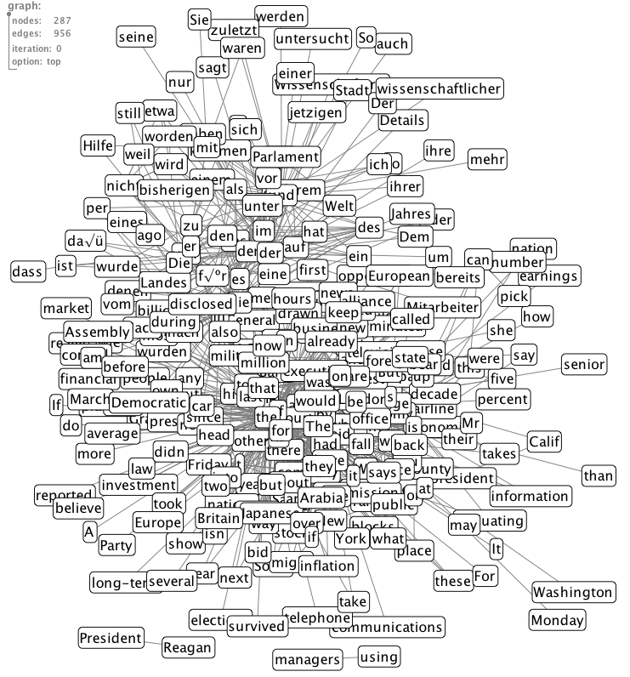
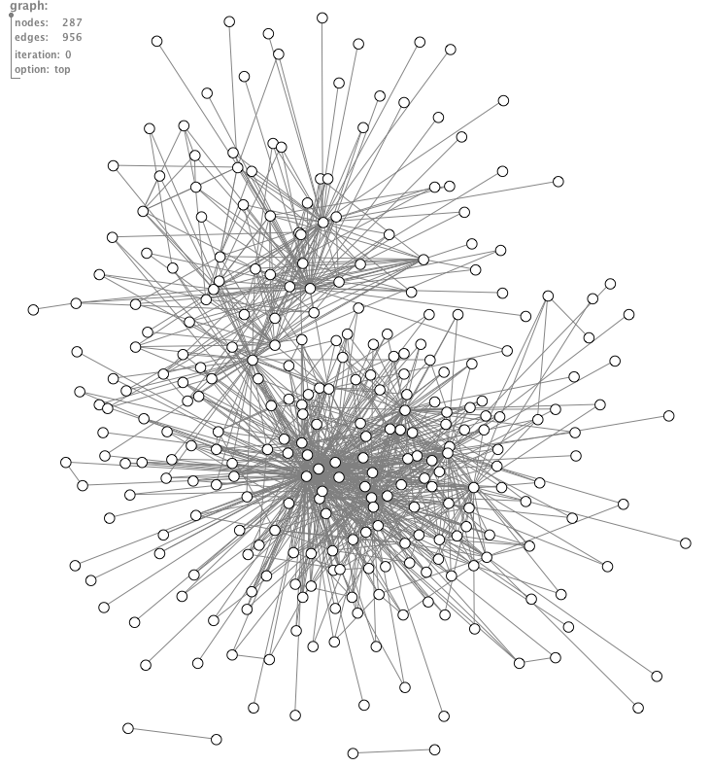
Unsupervised Language Separation
Multilingual word co-occurrence graph is connected: some words are used in several languages, the same names are also used throughout.
Cluster the multilingual word co-occurrence graph and use cluster members to identify sentences/documents belonging to that cluster
18/06/19
Language Technology Group – Chris Biemann

Slide 29
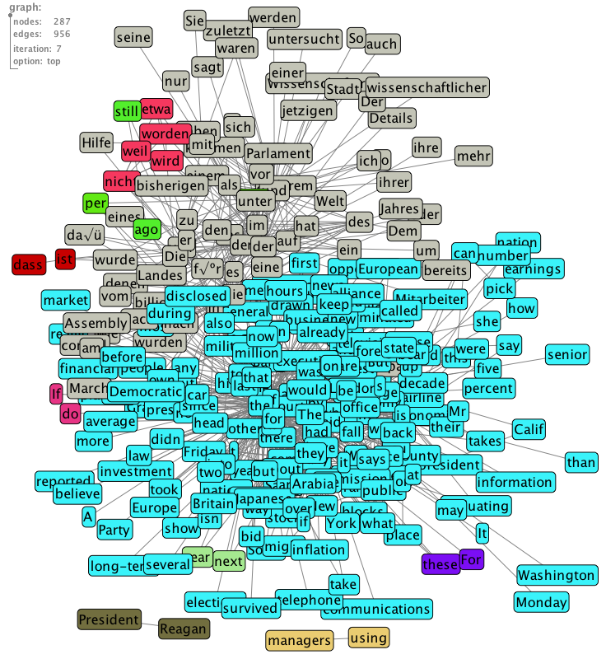
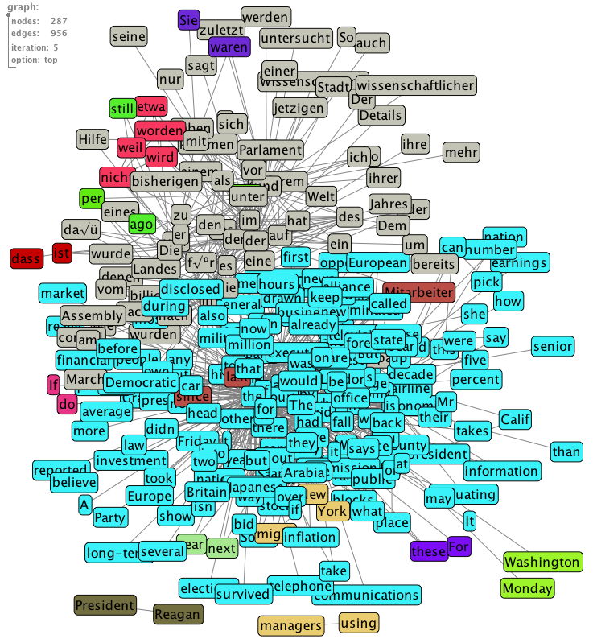
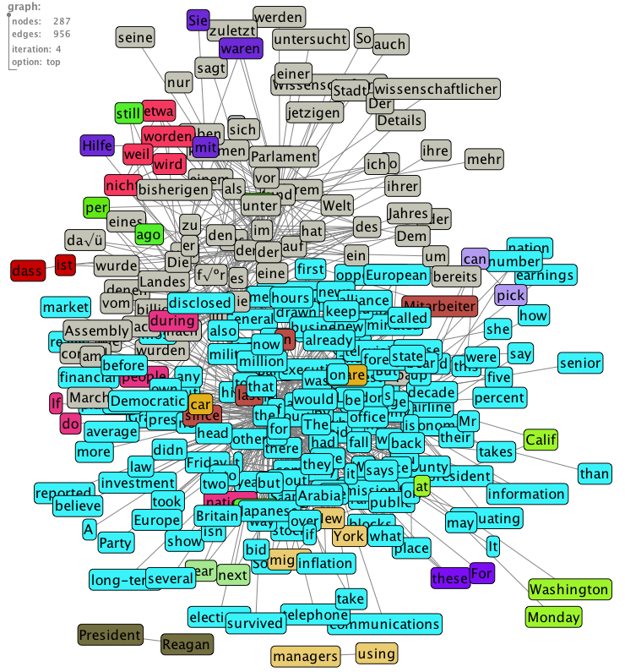
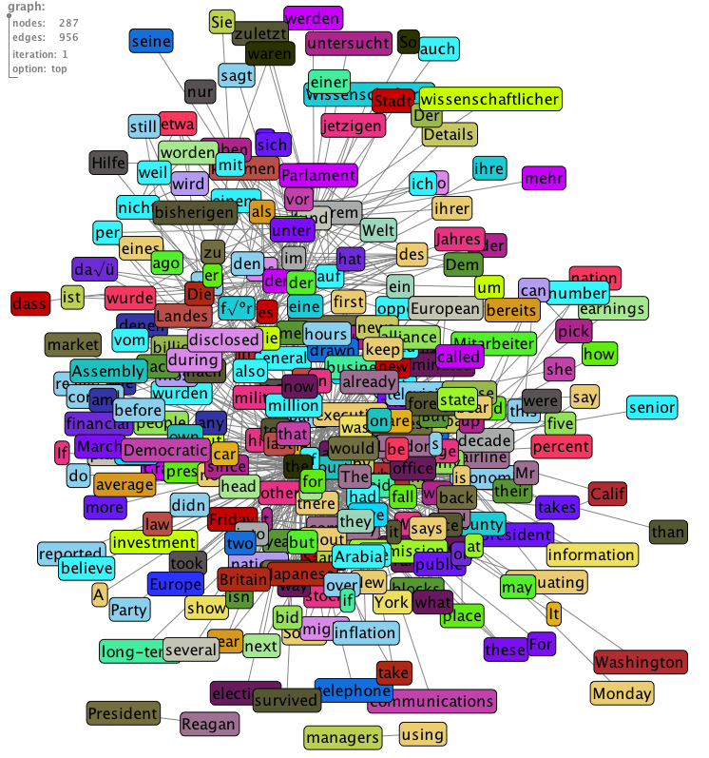
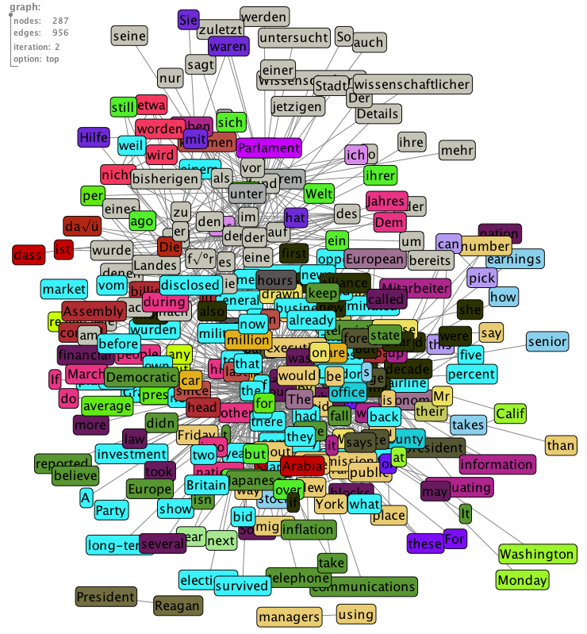
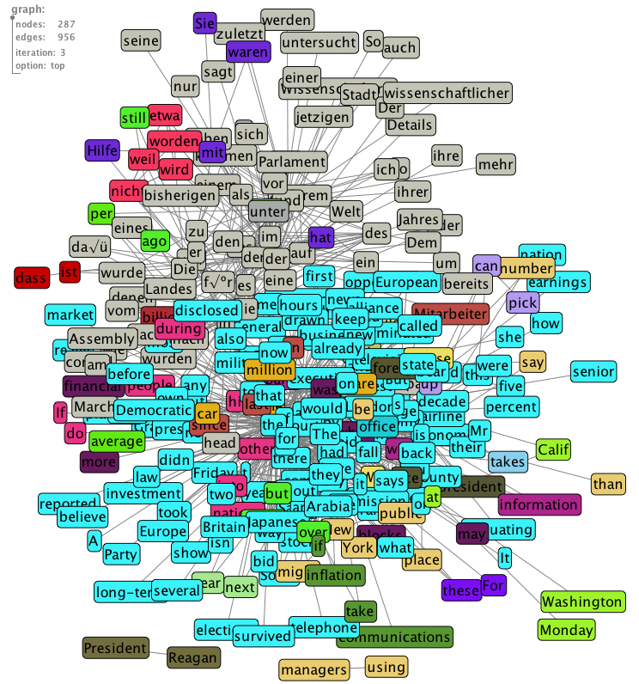
Clustering with Chinese Whispers
Random Initialization
Iteration 1
Iteration 2
Iteration 3
Iteration 4
Iteration 5
Stop
18/06/19
Language Technology Group – Chris Biemann

Slide 30
Distributional Hypothesis (Recap)
The Distributional Hypothesis in linguistics is the theory that words that occur in similar contexts tend to have similar meanings.
The Distributional Hypothesis is the basis for Statistical Semantics. It states that the meaning of a word can be defined in terms of its context.
Distributional Hypothesis:
words are characterized by their (typical) contexts: meaning of a word can be defined in terms of its context
words are more similar, the more contexts they share
Any process that builds a structure on sentences can be used as a source for contexts
18/06/19
Language Technology Group | Chris Biemann

Slide 31
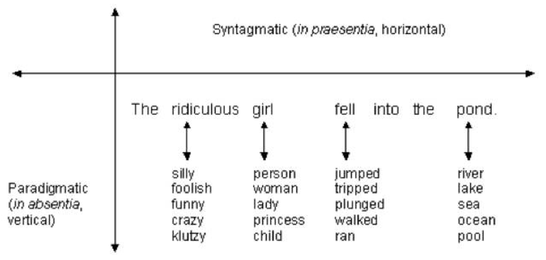
Syntagmatic vs. Paradigmatic Relations
Ferdinand de Saussure
http://courses.nus.edu.sg/course/elltankw/history/Vocab/B.htm
Syntagmatic Relations: syntactic constraints in the context
Paradigmatic Relations: associations, semantic constraints
Ferdinand de Saussure. Cours de linguistique generale. Paris: Payot, 1916
18/06/19
Language Technology Group | Chris Biemann

Slide 32
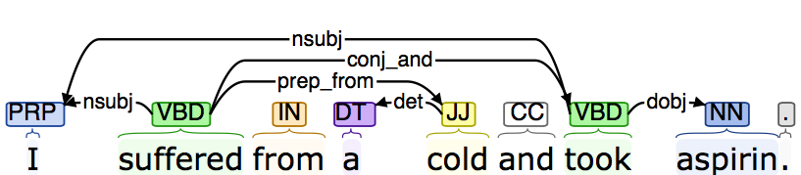
The @@ operation: producing pairs of Terms and Contexts
SENTENCE:
I suffered from a cold and took aspirin.
STANFORD COLLAPSED DEPENDENCIES:
nsubj(suffered, I); nsubj(took, I); root(ROOT, suffered); det(cold, a); prep_from(suffered, cold); conj_and(suffered, took); dobj(took, aspirin)
TERM-CONTEXT PAIRS:
http://nlp.stanford.edu:8080/parser/
suffered nsubj(@@, I) 1
took nsubj(@@, I) 1
cold det(@@, a) 1
suffered prep_from(@@, cold) 1
suffered conj_and(@@, took) 1
took dobj(@@, aspirin) 1
I nsubj(suffered, @@) 1
I nsubj(took, @@) 1
a det(cold, @@) 1
cold prep_from(suffered, @@) 1
took conj_and(suffered, @@) 1
aspirin dobj(took, @@) 1
18/06/19
Language Technology Group | Chris Biemann

Slide 33
Distributional Thesaurus (DT)
Computed from distributional similarity statistics
Entry for a target word consists of a ranked list of neighbors
First order
amod(Church,@@)
meeting
meeting 288
meetings 102
hearing 89
session 68
conference 62
summit 51
forum 46
workshop 46
hearings 46
ceremony 45
sessions 41
briefing 40
event 40
convention 38
gathering 36
...
articulate
articulate 89
explain 19
understand 17
communicate 17
defend 16
establish 15
deliver 14
evaluate 14
adjust 14
manage 13
speak 13
change 13
answer 13
maintain 13
...
immaculate
amod(condition,@@)
perfect
amod(timing,@@)
nsubj(@@,hair)
cop(@@,remains)
Second order
immaculate
3
perfect
18/06/19
Language Technology Group | Chris Biemann

Slide 34
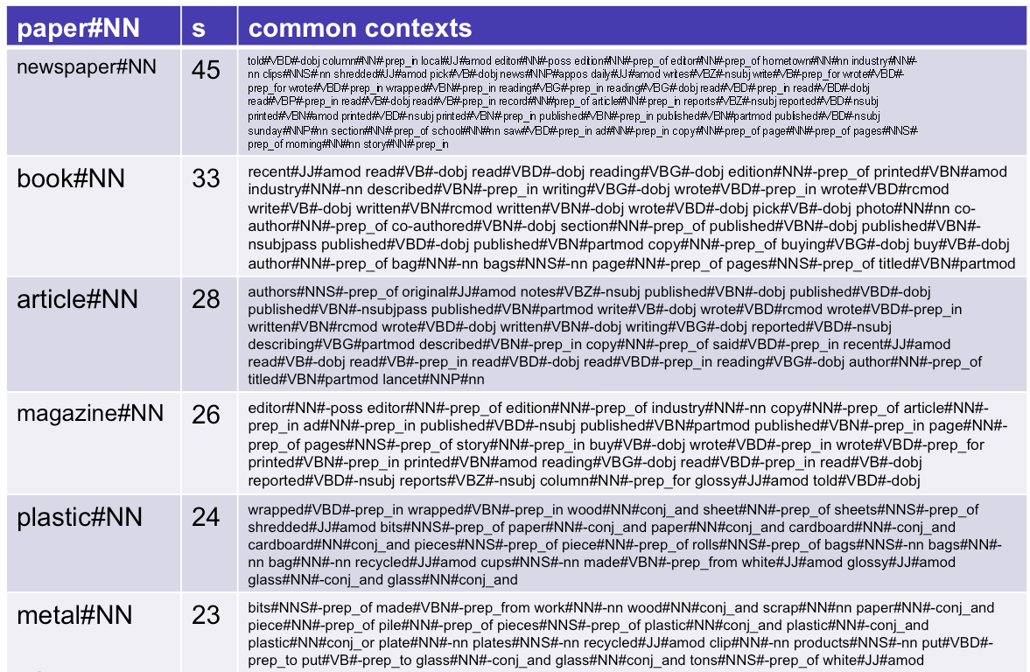
DT entry “paper#NN” with contexts
x
newspaper
article
magazine
book
plastic
metal

Slide 35
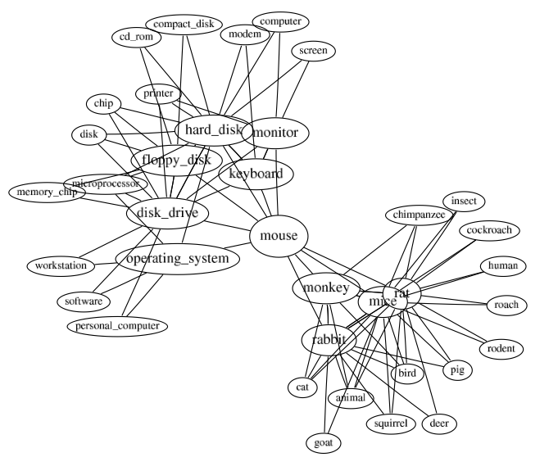
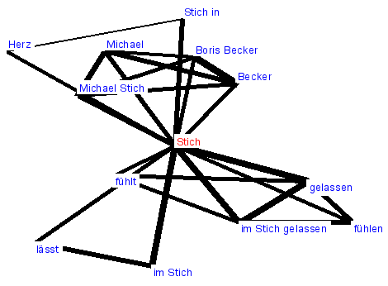
Word Sense Induction
Some words have several meanings
different meanings appear in different contexts
global contexts are represented by co-occurrences
➔ Cluster the co-occurrence graph to get contexts per meaning
“Discovering corpus-specific word-senses”, Beate Dorow, Dominic Widdows, 10th Conference of the European Chapter of the Association for Computational Linguistics (Conference Companion), 2003, pp. 79-82.
18/06/19
Language Technology Group | Chris Biemann

Slide 36
Ambiguity detection example
1. Retrieve co-occurrence graph neighborhood of “arm”
pistol
leg
firearm
arm
elbow
blade
limb
18/06/19
Language Technology Group | Chris Biemann

Slide 37
Steps in Clustering
1. Retrieve co-occurrence graph neighborhood of “arm”
2. Remove target word
pistol
leg
firearm
elbow
blade
limb
18/06/19
Language Technology Group | Chris Biemann

Slide 38
Steps in Clustering
1. Retrieve co-occurrence graph neighborhood of “arm”
2. Remove target word
3. Retrieve edges for present nodes
pistol
leg
firearm
elbow
blade
limb
18/06/19
Language Technology Group | Chris Biemann

Slide 39
Steps in Clustering
1. Retrieve co-occurrence graph neighborhood of “arm”
2. Remove target word
3. Retrieve edges for present nodes
4. Apply graph clustering
pistol
leg
firearm
elbow
blade
limb
18/06/19
Language Technology Group | Chris Biemann

Slide 40
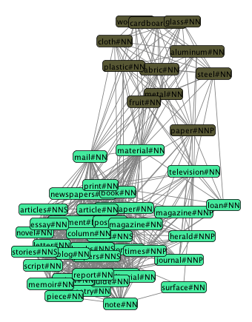
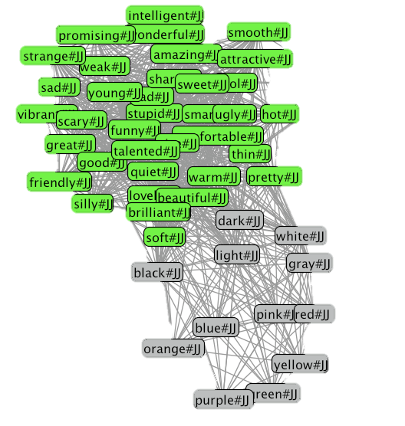
Sample Results
paper#NN
bright#JJ
18/06/19
Language Technology Group | Chris Biemann
40

Slide 41
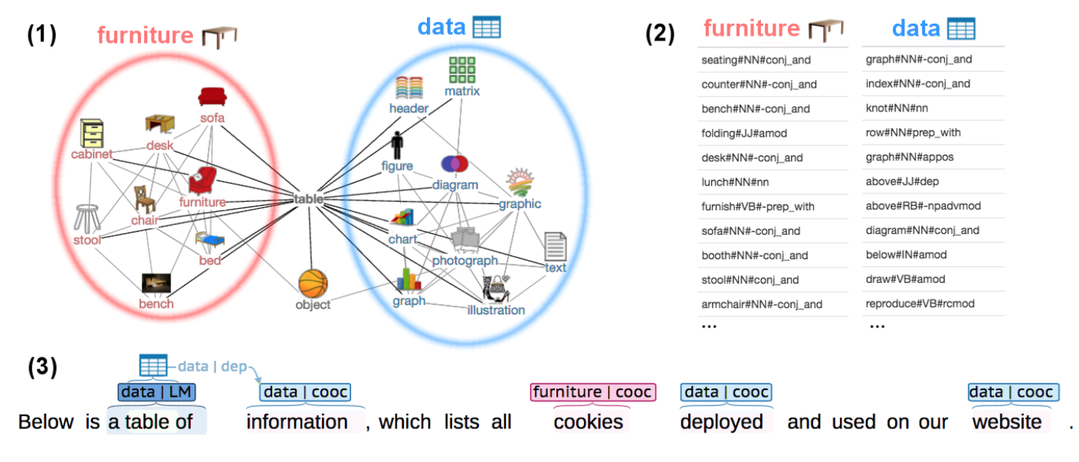
Interpretable Word sense induction and disambiguation
Induction of interpretable word sense inventory
interpretable disambiguation mechanism
Panchenko, A., Ruppert, E., Faralli, S., Ponzetto, S. P. and Biemann, C. (2017): Unsupervised Does Not Mean Uninterpretable: The Case for Word Sense Induction and Disambiguation. Proceedings of EACL 2017, Valencia, Spain.
18/06/19
Language Technology Group | Chris Biemann
41

Slide 42
Interpretability and Robustness of Representation
Why are ‘anaconda’ and ‘python’ similar?
largest point of critique on dense vector representations:
lack of interpretability of dimensions
when using random sampling methods: re-running the procedure results in different values
Sparse (graph-based) models:
readable
deterministic / reproducible on same corpus
robust: similar representations on similar corpora
because their cosine similarity is 0.95, being most similar in dimensions 54, 3 and 8 while being least similar in dimensions 90, 22 and 15 using random seed 0.
because they share 36 significant syntactic contexts, of which the most salient are: they coil up, are snakes, swallow, digest, gorge, tighten, and co-occur in conjunctions with other snakes such as rattlesnake, cobra, ..
18/06/19
Language Technology Group | Chris Biemann

Slide 43
Summary on Graph-based Methods for NLP
Graph representation is a natural representation of items and their relations
Can use well-known graph algorithms for the solution of specific NLP problems
Taking the overall structure into account improves some NLP tasks
Graph clustering algorithms solve unsupervised NLP tasks without the need to specify the number of clusters
18/06/19
Language Technology Group | Chris Biemann

Slide 44


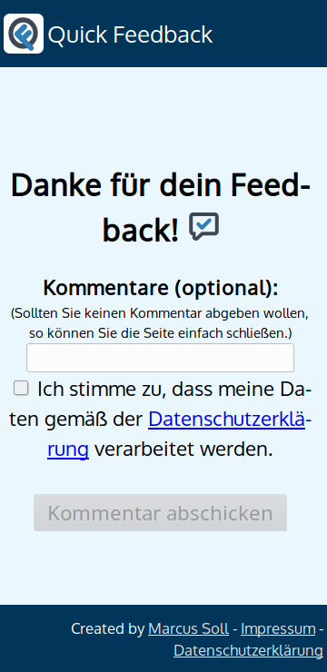
Immediate Feedback
s

Slide 45
Word Sense AND MEANING
coming up next
knowledge-based, supervised, word sense induction
18/06/19
Language Technology Group | Chris Biemann

